Slide 1

Minor Project-1
on
Image Segmentation using U-Net Architecture
Under the supervision of
Dr. Rajib Ghosh
Presented by : Group 18 (Alokkumar Anshuman Bharti, Amar Ram, Ankit Kumar)

Slide 2
Contents
Introduction
Literature survey
Research problem
Dataset description
Proposed method
Result
Conclusion and future scope
References

Slide 3
Introduction
The satellite image analysis system are costly in terms of infrastructure.
On the other hand, the Unmanned Aerial Vehicle (UAV) based image analysis systems are one of the cheaper solution in the different applications mentioned below.
Agriculture planning
Military target identification
Damage estimation
Rescue operations in natural disasters
Terrain classification

Slide 4
Introduction (contd.)
UAV based image analysis systems performs various tasks.
Image classification
Object detection
Image segmentation

Slide 5
Literature survey
Table 1: A few studies in the field of image analysis
Study | Task | Image type | Features | Classifier | Results
[1] | image segmentation | aerial images | Convolutional | TreeUNet | 89.3 (mean F1)
[2] | image segmentation | aerial images | Convolutional | LinkNet (ResNet34) | 94.76 (F_score)
[3] | image segmentation | Brain images | Convolutional | ResNets | 86 (Accuracy)
[4] | image segmentation | aerial images | Convolutional | fuzzy local information C-means (FLICM) | 82.7 (Accuracy)

Slide 6
Literature survey (contd.)
Study | Task | Image type | Features | Classifier | Results
[5] | image segmentation | aerial images | Convolutional | J-measure-based segmentation method | 93 (Accuracy)
[6] | image segmentation | aerial images | Convolutional | Multiscale Optimization Procedure | 20-40% improvement
[7] | image segmentation | aerial images | Convolutional | U-net | 82 (Accuracy)
[8] | image segmentation | aerial images | Convolutional | FCN | 87.9 (Accuracy)
[9] | image segmentation | aerial images | Convolutional | (Evo.NAS) SLGENet-3 | 92.1 (Accuracy)
[10] | image segmentation | aerial images | Convolutional | MultiScale CNN | 99.4 (Accuracy)

Slide 7
Research problem
Image segmentation on the real world data that will identify the four classes listed below.
Road
Vegetation
Background
Occluded road

Slide 8
Dataset description
Table 2 : Number of images in each resolution
Resolution (720 x 1280) | Resolution (2160 x 4096) | Resolution (3000 x 4000)
31 | 51 | 19
Table 3 : Number of images in each set
Training set | Validation set | Testing set
56 | 14 | 31

Slide 9
Figure 1. A sample image from NITRDrone_dataset containing UAV captured aerial outdoor images

Slide 10
Proposed method
This research work proposes a U-shaped convolutional neural network (U-Net)

Slide 11
Proposed method (contd.)
Architecture of U-Net
Encoder block
Skip connections
Bridge
Decoder block

Slide 12
Result
In the proposed model “adam” optimizer is used and Cross Entropy is used as loss function.
The model is trained for 3 epochs with few images having batch size of 8.
Figure 2 and Figure 3 shows the output of the proposed model.

Slide 13
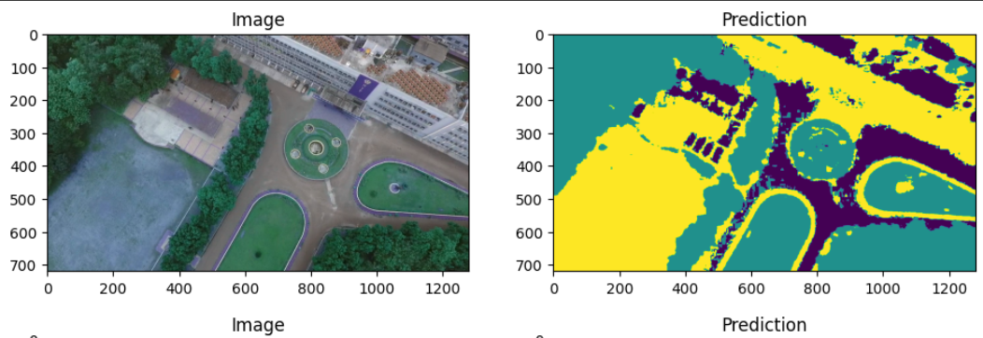
Result (contd.)
Figure 2: Segmented image of a test image

Slide 14
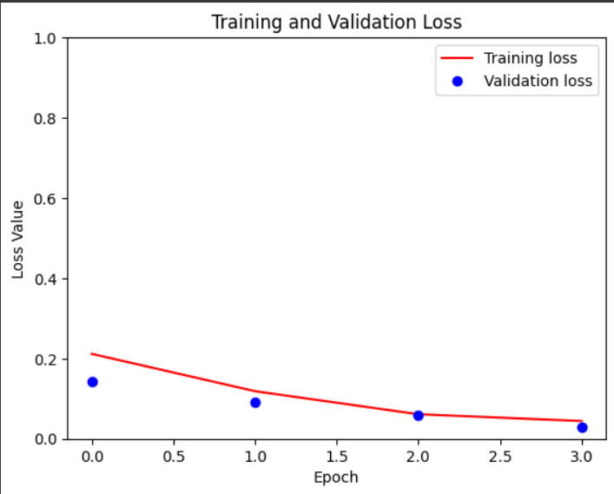
Result (contd.)
Figure 3: Training and validation loss of the model
Code

Slide 15
Conclusion and future scope
Image segmentation is a critical task in computer vision that involves dividing an image into multiple segments or regions to extract meaningful information from it.
The use of this technique has resulted in various applications, such as:
Object recognition
Medical imaging
Autonomous driving

Slide 16
Conclusion and future scope (contd.)
There are still some challenges and limitations in image segmentation, such as:
Difficulty of segmenting complex scenes.
Lack of annotated data for certain domains.
Trade-off between accuracy and speed.
The result of the proposed u-net model is not much proficient, hence there is need of some another method to increase the accuracy.

Slide 17
References
[1] Yue, K., Yang, L., Li, R., Hu, W., Zhang, F., & Li, W. (2019). TreeUNet: Adaptive tree convolutional neural networks for subdecimeter aerial image segmentation. ISPRS Journal of Photogrammetry and Remote Sensing, 156, 1-13.
[2] Gupta, A., Watson, S., & Yin, H. (2021). Deep learning-based aerial image segmentation with open data for disaster impact assessment. Neurocomputing, 439, 22-33.
[3] An efficient brain tumor image segmentation based on deep residual networks (ResNets)
[4] Li, N., Huo, H., Zhao, Y. M., Chen, X., & Fang, T. (2013). A spatial clustering method with edge weighting for image segmentation. IEEE Geoscience and Remote Sensing Letters, 10(5), 1124-1128.
[5] Wang, Z., & Boesch, R. (2007). Color-and texture-based image segmentation for improved forest delineation. IEEE Transactions on Geoscience and Remote Sensing, 45(10), 3055-3062.

Slide 18
References (contd.)
6] Esch, T., Thiel, M., Bock, M., Roth, A., & Dech, S. (2008). Improvement of image segmentation accuracy based on multiscale optimization procedure. IEEE Geoscience and Remote Sensing Letters, 5(3), 463-467.
[7] Du, G., Cao, X., Liang, J., Chen, X., & Zhan, Y. (2020). Medical image segmentation based on u-net: A review. Journal of Imaging Science and Technology.
[8] Kaiser, P., Wegner, J. D., Lucchi, A., Jaggi, M., Hofmann, T., & Schindler, K. (2017). Learning aerial image segmentation from online maps. IEEE Transactions on Geoscience and Remote Sensing, 55(11), 6054-6068.
[9] Broni-Bediako, C., Murata, Y., Mormille, L. H., & Atsumi, M. (2021). Evolutionary NAS for aerial image segmentation with gene expression programming of cellular encoding. Neural Computing and Applications, 1-20.
[10] Behera, T. K., Bakshi, S., Nappi, M., & Sa, P. K. (2023). Superpixel-Based Multiscale CNN Approach Toward Multiclass Object Segmentation From UAV-Captured Aerial Images. IEEE Journal of Selected Topics in Applied Earth Observations and Remote Sensing, 16, 1771-1784.

Slide 19
Thank you

